Slide 1
PROMOTING ECOCENTRIC OVER ANTHROPOCENTRIC VALUES IN A BUILT ENVIRONMENT THROUGH ENVIRONMENTAL EDUCATION
By
Wonne Afronelly O.
Dennis Ejike Amadi
Chima Ichendu.

Slide 2
Today, the mechanized man is capable of defacing the Sun despite its hotness, was it close and within man’s reach; just to satisfy his quest for pleasurable comfort even to the detriment of his neighbour (man).
This paper sought to bring to the fore the key concepts that promote ecocentric values especially within the built environment.
A strong synergy between all stakeholders and professionals through environmental education proves to be a solid foundation to achieving ecocentric values in a built environment.

Slide 3
INTRODUCTION
The abuse on land is subject to the regard that it is a commodity that belongs to man. Until man sees land as an integral part whose action and reaction are equal and opposite, then the need to care for it. Then there is no other way to survive the impact of mechanized man (Leopold 1949)
Plants may be slow to react and are often helpless. Looking at our reactions towards animals in distress, let us treat plants alike. We should respect their right to the pursuit of happiness which isn't less than our own. Let us therefore heed the call for a complete moratorium on the use of all living things!

Slide 4
INTRODUCTION CONT’D
Environmental crises, such as indiscriminate waste disposal, black soot, global warming, water pollution, species extinction and wild land destruction, are some of the most important problems currently facing our society.
How we deal with these problems largely depends on how we perceive our relationship with the land.
Do we view nature as property for us to use however we wish for our own benefit, or does nature have intrinsic value, value aside from its usefulness to humans?
You should have an ecocentric based answer.

Slide 5
DEFINITION OF KEY THEMES
Anthropocentrism considers humans to be the most important life form, and other forms of life to be important only to the extent that they affect humans or can be useful to humans.
Ecocentricm asserts that all components of the environment have intrinsic values
Environmental ethics takes into consideration, obligations humans have concerning the environment.
Stakeholders are persons or organisations with a legitimate interest in a given situation, action or enterprise.
Synergy combined healthy action of every organ of a particular system

Slide 6
ENVIRONMENTAL EDUCATION (EE)
Environmental Education
Stakeholders categorized into 10:
THOSE WHO NEED EE
  market men and women
  pedestrians/hawkers/street marketers/road sellers
  individuals, households and consumers
  visitors and tourists
  motorists and motor parks, all road users

Slide 7
ROLES OF STAKEHOLDERS WHO PROFFER EE
educational institutions
media
government and labour unions
grassroot organizations and local communities
Corporate entities and industries

Slide 8
ANALYSIS OF BROADCAST MEDIA STATIONS THAT PROMOTE ENVIRONMENTAL EDUCATION IN PORT HARCOURT
Figure : Source –“My Environment My Wealth” 2016, https://www.facebook.com/myEmyWealth/

Slide 9
UNDERSTANDING CORPORATE SOCIAL RESPONSIBILITY (CSR) – ECOCENTRIC CSR AS A TOOL FOR PROFESSIONALS
Ecocentric management is one type of CSR that adopts a deeply ecological view of business.
The ecocentric model differs from more human-centered interpretations of sustainability or responsibility.
It values environmental good above economic or even social benefits.
For this reason, ecocentric CSR activities, more than any other type of CSR efforts, are not expected to provide business benefits.
Instead, they reflect an organization's commitment to the environment as the primary core value for conducting business

Slide 10
BUILT ENVIRONMENT PROFESSIONALS
The concept of PLACE (Planning, Landscape, Architecture, Conservation and Engineering), Farrell (2014) is recognised as a critical way of viewing the built environment and the people who use it.
Sustainable Urban Development through Trees and Green Spaces
Economic and environmental benefits of trees are often overlooked
insufficient open green spaces for the planting of trees are usually
The simple habit of deliberate inclusion of trees and green spaces in urban development programs will definitely ensure liveable, sustainable and resilient urban settlements (Ichendu et al., 2016).

Slide 11
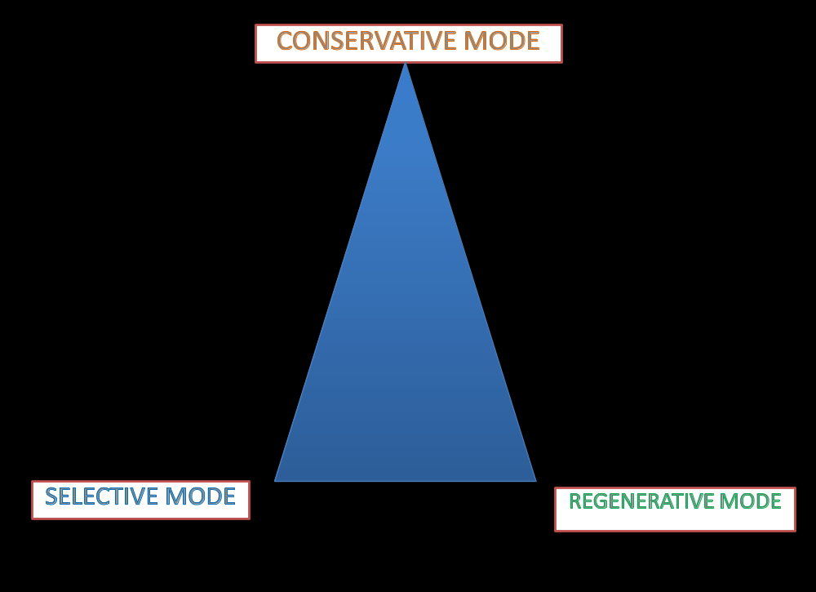
BUILT ENVIRONMENT PROFESSIONALS CONT’D
The role of Built Environment Professionals need to be communicated every way possible so that both professionals and other stakeholders of the environment especially the lay men (clientele) have a good understanding
Figure 2: Banham's Categorisation Source Architecture & Environmentalism Vol. 6, Issue 1, 2004

Slide 12
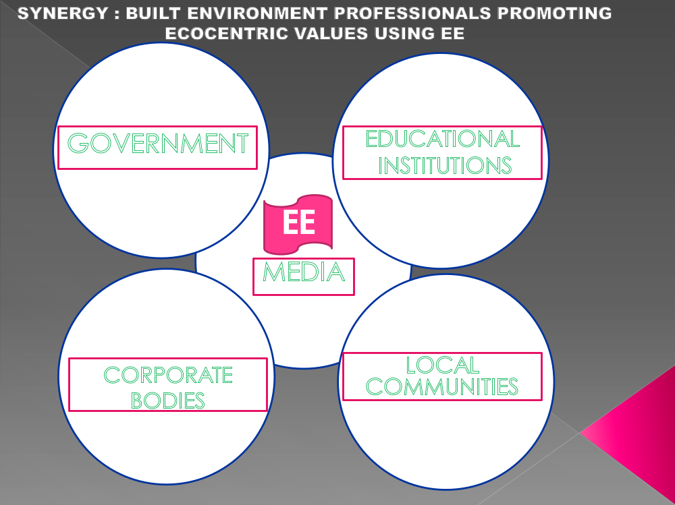
STAKEHOLDERS’ SYNERGY IN SUSTAINABILITY
Figure 3: stakeholders’ synergy in promoting ecocentric values

Slide 13
CONCLUSIONS AND RECOMMENDATIONS
A well informed society will no doubt be a well equipped society. Information is power. All stakeholders of the environment must learn to adopt and adapt EE as a basic tool in actualizing realization of a deeper ecocentric relationship with nature which relies on the achievement of a deeper relationship with our own built environment. We all need to stay connected to nature.
The following recommendations can help the built environment professionals:
Establish environment clubs in schools at all levels both formal and informal institutions
Incorporate Public speaking skills in built environment courses (e.g, architecture)
Incorporate Rural extension training skills in built environment courses (e.g urban planning)
Occasionally, short skits could be acted and projected by the visual broadcast media e.g highlighting the benefits of tree planting and conservation of the environment

Slide 14
RECOMMENDATIONS CONT’D
Set up community radio stations and programs that communicate in local dialects to guide infrastructural development in fast developing rural towns and prevent future problems
Extension programs and sensitization should be done often in fast developing rural towns
Pamphlets, stickers and other visual pictorial representations of a safe built environment can be made available to individuals, households and local communities
Partnership with ongoing programs on media environment advocacy
The statutory bodies responsible for building/development project approvals should make strong policies to include tree planting and provision of green spaces as key criteria for building/property development design approvals
Firms should promote only ecocentric based CSR e.g. Banks should only approve loans for structures after they confirm it meets set standards that preserve the environment.
Finally community policing by everyone should be encouraged by all built environment professionals to ensure all stakeholder categories help in actualizing an ecocentric society.

Slide 15
FOR LISTENING
THANK YOU

